Slide 1
Image Segmentation
Computer Vision
Assignment 2

Slide 2
Overview
Task 1: implement Mean-Shift to segment image (40 pts).
Task 2: implement simplified SegNet on multi-digit MNIST dataset (60 pts).
Notes:
This assignment concerns with 2 tasks. In the first task you need to implement mean-shift algorithm and use it to segment an image. In the second task you need to implement a simplified version of SegNet and train models on multi-digit MNIST dataset.

Slide 3
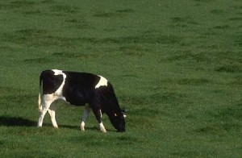
Mean-Shift
Input image
Input Image
Notes:
In the first task, you are given an input image.

Slide 4

Mean-Shift
Goal – segment the image in CIELAB color space (preprocessing already provided in code)
Expected Segments
Notes:
And you need to implement mean-shift algorithm to segment the image in CIELAB color space.

Slide 5
Mean-Shift
In each step, for each point:
Compute the distances from this point to all points (including current point) within a radius. In this assignment we set this radius to positive infinity so that you can have an easier implementation
Compute weight of every point as a Gaussian kernel function of distance, with bandwidth=2.5
Compute weighted mean of all points (including current point), then update current point with this weighted mean
Notes:
Here is the detailed walkthrough of the mean-shift algorithm you need to implement.

Slide 6
Mean-Shift – Implementation Details
Within each mean-shift step, you should update all points out of place, i.e the order of update should not affect the final output.
Run 20 steps.
After implementing the basic mean-shift algorithm, try to accelerate it by taking advantage of batch processing.

Slide 7
Mean-Shift
Pseudo code
while not_converged(): for i, point in enumerate(points): # distance for the given point to all points distances = distance(point, points) # turn distance into weights using a gaussian weights = gaussian(dist, bandwidth=2.5) # update the point by calculating weighted mean of all points points[i] = update_point(weight, X) return points
Notes:
Here is the pseudo code of the algorithm. Basically you need to fill out three functions, which are distance, gaussian, and update_point.

Slide 8
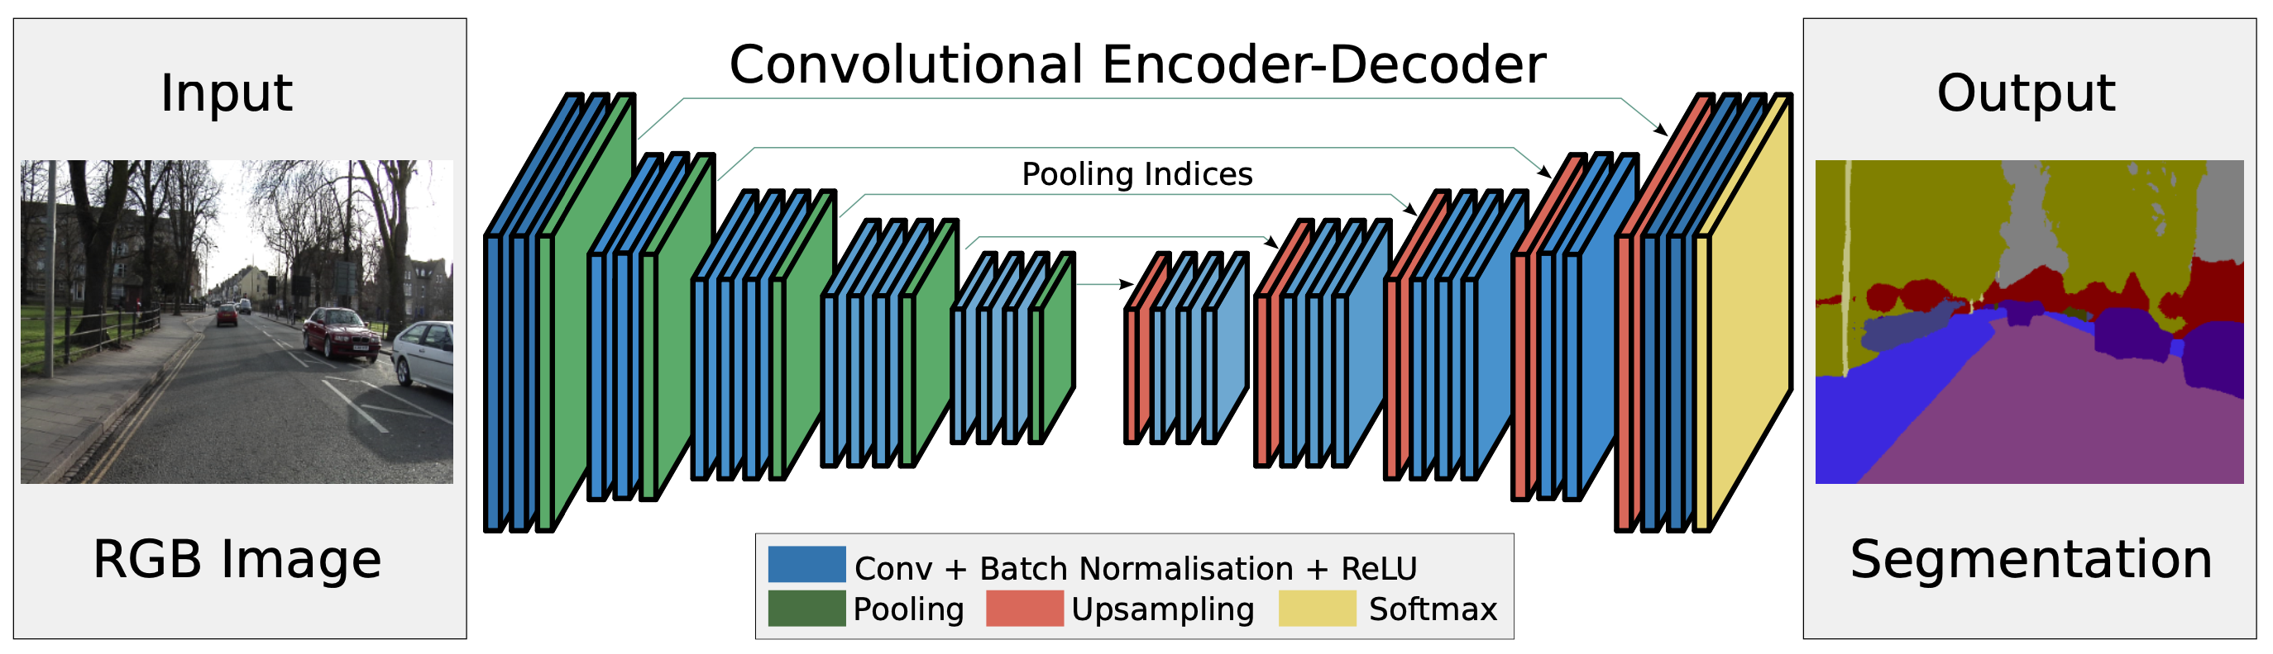
SegNet – From the Lecture
Notes:
The second task concers with implementing a simplied version of SegNet which was introduced in the lecture.

Slide 9
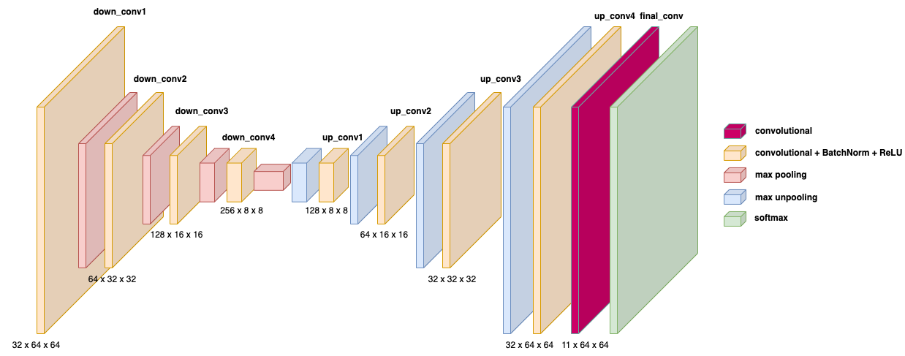
SegNet – Simplified Version
Notes:
For this simplified version, we will have one convolution per block instead of multiple convolutions. The numbers in this slide indicate dimensions of output tensor of each convolution layer.

Slide 10
Basic Modules
Conv2d, BatchNorm2d, MaxPool2d and MaxUnpool2d
Notes:
The modules you need to build this network include Conv2d, BatchNorm2d, MaxPool2d and MaxUnpool2d. Since you already learned about Conv2d and MaxPool2d in the last assignment, we will skip them here and talk about the other two modules.

Slide 11
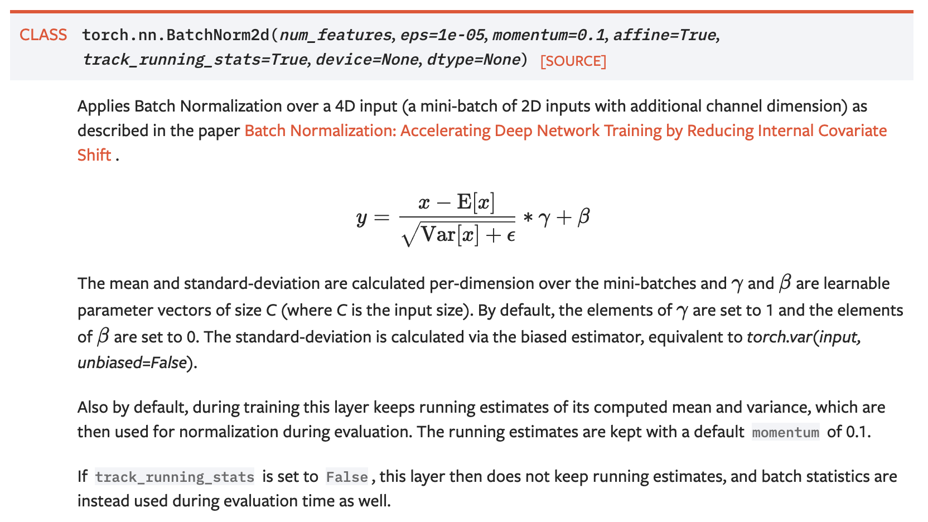
Basic Modules – BatchNorm2d
https://pytorch.org/docs/stable/generated/torch.nn.BatchNorm2d.html
Notes:
BatchNorm layer aims to normalize the outputs of a certain layer. In this way it can make the training process converge faster while also generalize better. Here in the equation, E and V represents mean and variance computed per-minibatch, while gamma and beta constitutes a learnable affine transformation. By default, the Batchnorm layer maintains running mean and variance internally and update them with a momentum during training, while at testing it fixes these running mean and variance and use them for normalizatoin. Usually you don’t need to change the default hyperparameters of this Module.

Slide 12
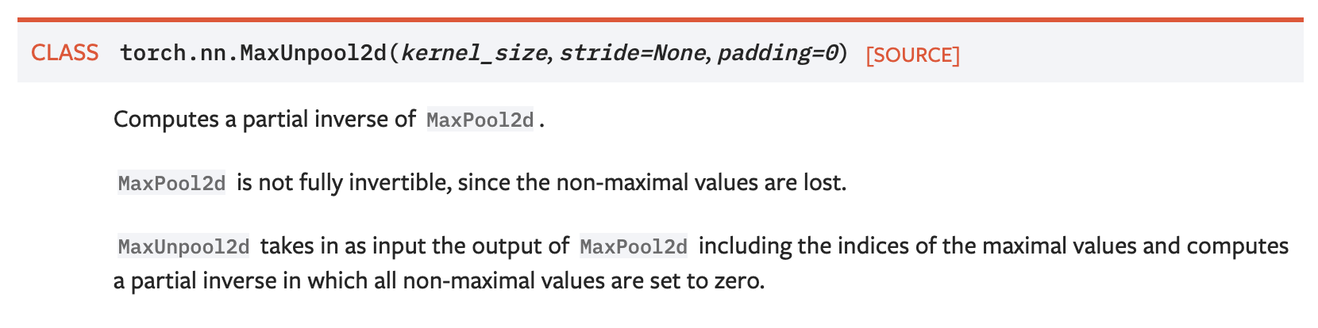
Basic Modules – MaxUnpool2d
https://pytorch.org/docs/stable/generated/torch.nn.MaxUnpool2d.html
Notes:
MaxUnpooling was introduced in the lecture. Basically it takes the outputs of MaxPooling layer as inputs, including network activations and max indices. The output would be an unsampled tensor, with max values from max-pooling perserved while other non-max values setting to 0.

Slide 13
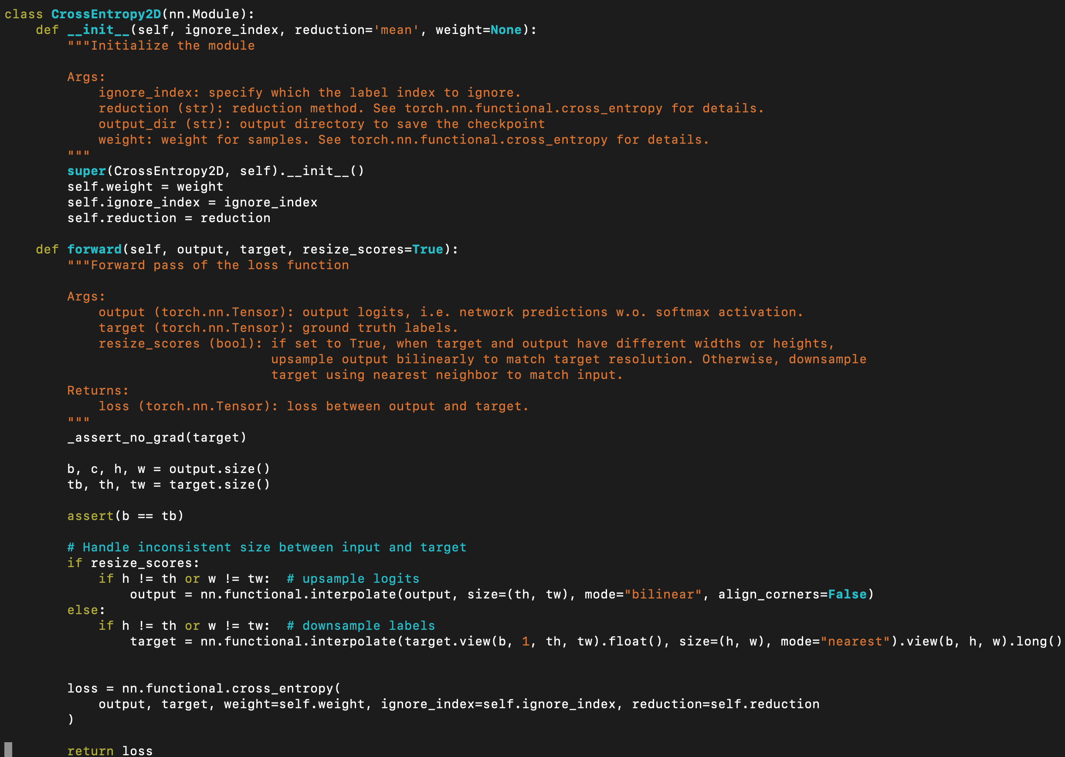
Loss – Per-pixel Cross-Entropy Loss
Notes:
Semantic segmentation is essentially a per-pixel classification problem, so you can just apply element-wise cross_entropy loss on your network’s output. Note that in PyTorch, the input to cross_entropy function should be unnormalized (i.e. without applying softmax).

Slide 14
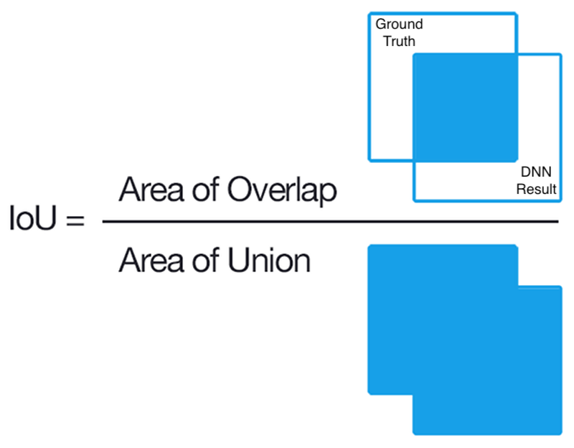
Evaluation Metric – Intersection Over Union
Notes:
To evaluation the semantic segmentation, we use the intersection over union metric, or IoU. Given the ground-truth mask and your predicted mask, IoU literally computes the value of the intersection of the two masks over the union of the two masks.

Slide 15


SegNet
Dataset – multi-digit MNIST
Input Image (64x64)
GT Labels
Notes:
You will be working on multi-digit MNIST dataset, in which hand-written numbers are placed randomly and you need classify for each pixel whether it belongs to one of the digits or to the background. So the number of classes would be 10 digits plus the background class.

Slide 16
Summary
Materials will be available later today.
Assignment 2 is due 05.11.2021 at midnight (11:59pm)
Notes:
This assignment concerns with 2 tasks. In the first task you need to implement mean-shift algorithm and use it to segment an image. In the second task you need to implement a simplified version of SegNet and train models on multi-digit MNIST dataset.

